Slide 1


Tutorial 1
Ali Chelli
Course: Business Intelligence and Data Warehousing (BID3000)

Slide 2
Practical Implementation of a DW

Slide 3
MySQL Installation
MySQL installation
https://dev.mysql.com/downloads/installer/
A step-by-step installation guide is found here
https://www.simplilearn.com/tutorials/mysql-tutorial/mysql-workbench-installation
SQL command Tutorial
https://www.w3schools.com/sql/default.asp

Slide 4
Importing a Database
To import a database from a self-contained single .sql file using MySQL Workbench, follow these steps:
Launch MySQL Workbench: Start the MySQL Workbench application on your computer.
Connect to a MySQL Server Instance:
On the welcome screen, under "MySQL Connections," click on your connection to establish a connection with the server.
Enter your password if prompted.
Go to Server Data Import:
Once you're connected, navigate to the "Server" menu on the top bar.
Choose "Data Import" from the dropdown menu.

Slide 5
Importing a Database
Choose Import File:
In the "Data Import" pane, select the "Import from Self-Contained File" option.
Click the three-dot button (...) next to the file path box to locate and select the .sql file you want to import.
Select Default Schema:
Click on the new button located on the right of Default Target schema. Inside the box fill in the name of the schema to create and call it cofeemerchant as shown in the figure in next slide.
Start the Import:
Once everything is set up, click on the "Start Import" button at the bottom right.
MySQL Workbench will begin the import process and show a progress update.

Slide 6
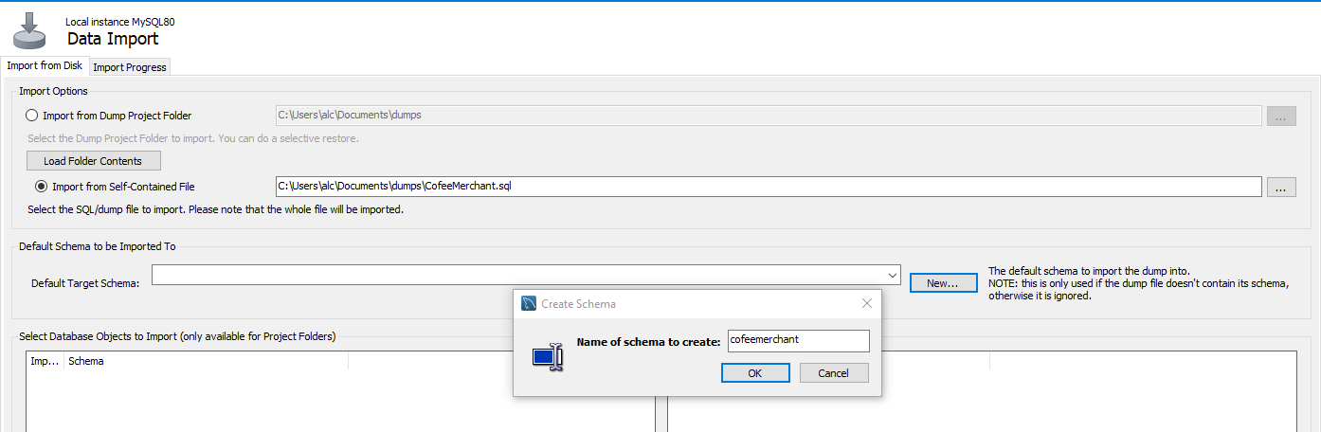
Importing a Database

Slide 7
Importing a Database
Verify the Import:
After importing, it's a good practice to check the data in the tables to ensure everything was imported correctly.
In the "Navigator" pane (on the left side), click on the database you imported data into, and browse the tables.

Slide 8
CoffeeMerchant’s Database:

Slide 9
The coffeemerchant Database
The cofeemerchant database contains the following tables:
Consumers, Countries, Employees, Inventory, OrderLines, Orders, States.
The relationships between the tables are created using foreign keys

Slide 10
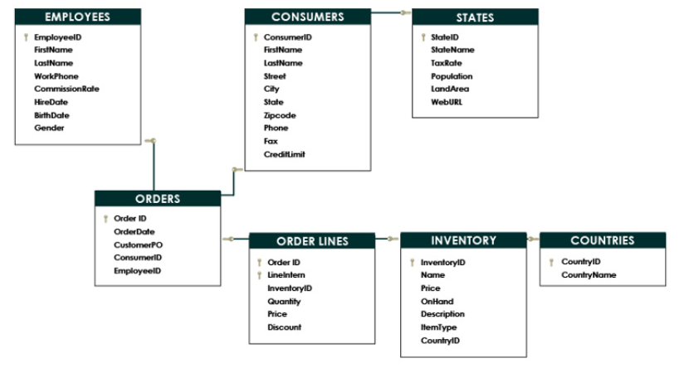
CoffeeMerchant’s Database ERD:

Slide 11
How we are going to make Business Intelligence Systems in this Course: A BI System for CoffeeMerchant
SQL-script
CoffeeMerchant
database
CoffeeMerchant
Datawarehouse
Power BI
Spoon
ETL

Slide 12
Building coffeemerchant Data Warehouse
SQL-script
CoffeeMerchant
database
CoffeeMerchant
Datawarehouse
Power BI
Spoon
ETL

Slide 13
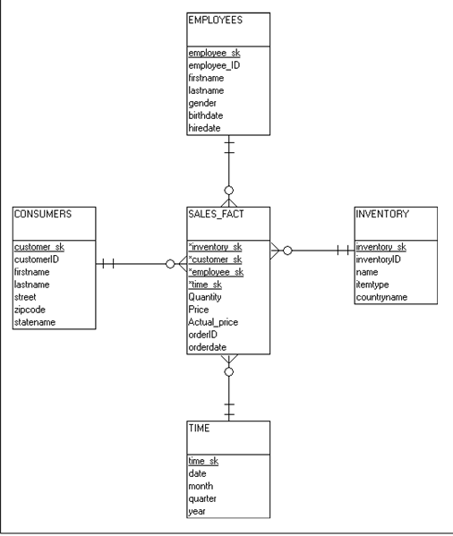
Building coffeemerchant Data Warehouse
As opposed to databases that follow relational models, data warehouse follow dimensional models.
The coffeemerchant Data Warehouse dimensional model: A star schema with one fact table and 4 dimensional tables
Fact Table: Sales_Fact
Dimension Tables:
Time,
Consumers,
Inventory,
Employee

Slide 14
Filling the Data Warehouse:
SQL procedure
dim_time
consumers
dim_customer
inventory
dim_inventory

Slide 15
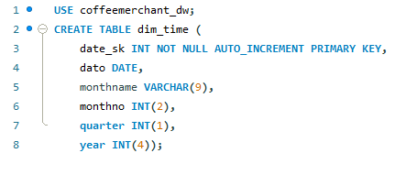
A Script to Create a Time Dimension Table:
First create a data warehouse called coffeemerchant_dw
CREATE DATABASE coffeemerchant_dw;
The Following script create a time dimension table called dim_time (Naming convention used to differentiate fact and dimension tables)

Slide 16
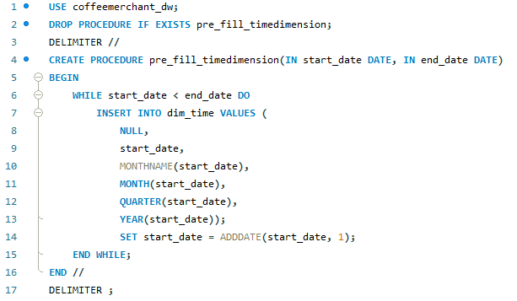
Script to Fill the Time Dimension Table:

Slide 17
Running the Time Dimension Script:
In the MySql editor, write
Click Execute

Slide 18
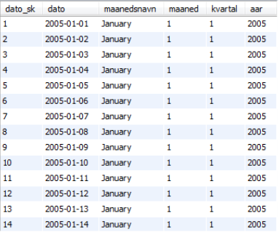
After Running the Script, this is the Content of the Time Dimension:

Slide 19
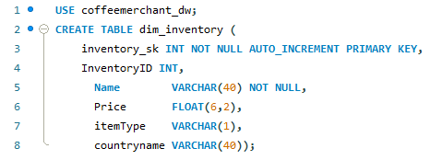
Create Dim_inventory
Creating the table:

Slide 20
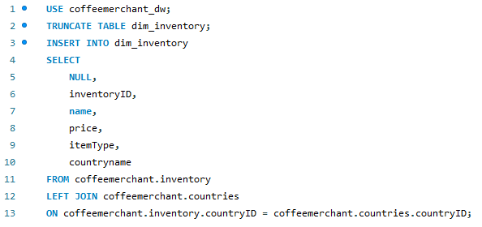
Fill dim_inventory:
Filling the table from the source database:

Slide 21
The Content of dim_inventory After Filling:

Slide 22
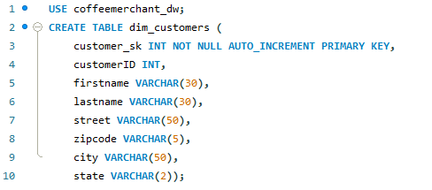
Create dim_customers:
Creating the table:

Slide 23
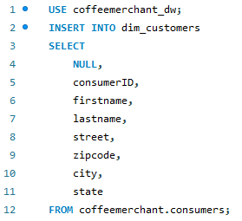
Fill dim_customers Table:
Filling the table from the source database :

Slide 24
dim_customers:

